Slide 1
Team Project
BY mOHAMMED baSIT, Ayman Yousfi and md nahain

Slide 2

Github account
LINK: GITHUB https://github.com/TeamUWLCS/Team-Project

Slide 3
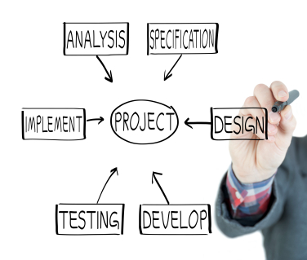
pROJECT maNAGER- Ayman Yousfi WHY?
Why we have chosen GUI application
opinion by Expertise
TEAM HAS Previous Experience
Research into design platform
Something UNIQUE
Improve our programming skills within java/graphic user interface

Slide 4

pROJECT maNAGER
ROLE?
Managing the progress of my team members, In terms of meeting task deadlines and allocating specified group meetings.
To make certain there is a solid communication system
Making sure each design collaborates with each other
Identifying potential improvement areas.
SUB CORE (DIVIDING ROLE)
Designing the GUI (individual classes)
Making sure the basic functions are implemented (java code)

Slide 5
pROJECT maNAGER
ISSUE!
Delayed to start our Team Project
Less Resources for our Team
Group member left the course
Group member couldn’t make it to allocated meetings for personal reasons
Effected our time scale and work rate

Slide 6

Gantt Chart Project Plan
Prgoress of the project in relation to the plan

Slide 7
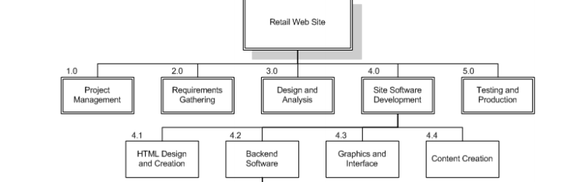
Work Break down structure
Esko Supermarket GUI
Project Management
Design Research
Design Platform
GUI Development
GUI Front end Design
Java operation
Back end Design
Database execution
Error/Bug fixing

Slide 8
Quality assurance
ROLE!
DESIGN OF APPLICATION(story board)
GITHUB-(updating github account)
Providing MULIMEDIA ELEMENTS(core)
RESEARCHING AND CREATING DATA BASE

Slide 9
Quality assurance
Project ASSURANCE – I shall identify the risks involved for their project and use the appropriate risk management process for the management of these risks.

Slide 10
Risk Register
Project Impact – how will those risk have impact.
WE AS TEAM TALK ABOUT THAT WE MIGHT FACE DURING THE PROJECT DEVELOPMENT
WHAT IS LIKELYHOOD NOT BEING ABLE COMPLE THIS ON TIME
SECURITY ISSUES- ssl certificate for checkout

Slide 11
Quality assurance Test!
TESTING-test out the application for usability and bugs.
Example
SAVING INTO DATABASE
PAYMENT going through
Program functionality(page link)

Slide 12
nAHAIN
Your roles and what you have done
Providing multi media elements and editing them (pictures, Photoshop, researcher)
Make sure u say that u wasn’t here a lot because u had personal issues(moving house)
Support with design

Slide 13
nAHAIN

Slide 14
nAHAIN

Slide 15
Application DEMO By Ayman Yousfi

Slide 16
OUR GOAL!

